Slide 1
Pixelate
Workshop
Path Planning

Slide 2
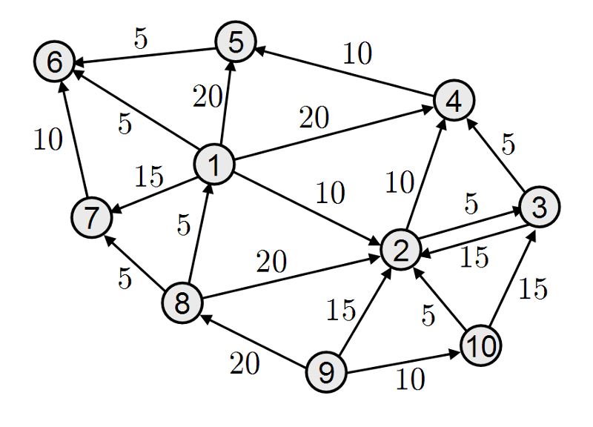
Graph:
Graph: A collection of Nodes or Vertices connected to each other through a set of Edges.

Slide 3
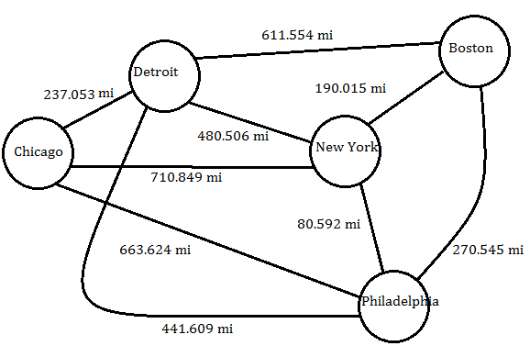
Example of A Graph: The Vertices are Cities and the Edges are roads
Note that here each road has a Weight attached to it i.e. Distance

Slide 4
Graph Types :
Undirected: Two Way roads. Basically, if you can get from Delhi to Mumbai then you can get from Mumbai to Delhi also
Directed: One Way Roads.
Weighted: Every edge has some weight associated with it. For example, the distance from Varanasi to Kanpur is less than distance from Varanasi to Mumbai

Slide 5
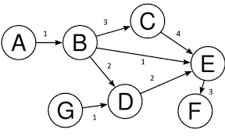
Directed Weighted Graph

Slide 6
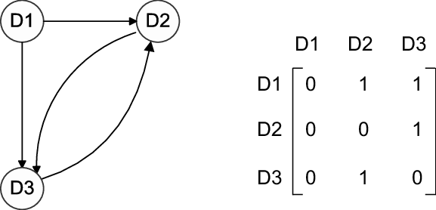
Adjacency Matrix: Method of representing Graph
The adjacency matrix, is a matrix with rows and columns labeled by graph vertices, with a 1 or 0 in position according to whether and are Connected or not.

Slide 7
Search vs Traversal
Search: Look for a given node stop when node found, even if not all nodes were visited
Traversal: Always visit all nodes

Slide 8
Breadth First Search:
Task is to get from point A to Point G

Slide 9
Depth First Search

Slide 11
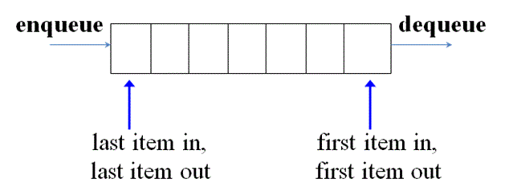
Before the Algorithm:
Queue or First In, First out(FIFO)
In Python to use a queue
from queue import Queue
q = Queue()
q.put(21) # Enqueue 21
item = q.get() # Dequeue 21
q = [ ]
q.append(21) # Enqueue 21
item = q.pop(0) # Dequeue 21
Or

Slide 12
BFS ALGORITHM (For unweighted graph)
Add root node to the queue, and mark it as visited(already explored).
While queue is not empty:
current node = top of queue; pop the top
For every non-visited child of the current node, do the following:
Mark it as visited. Mark current node as its parent
Check if it's the goal node, If so, then return it.
Otherwise, push it to the queue.

Slide 13
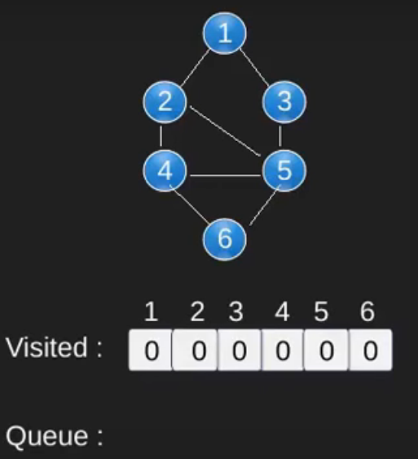
Initially, the visited array is filled with 0 and the queue is empty. The parent array is filled with -1 (no parent)
The root node is 1 and the goal is 6
Parent:
-1 | -1| -1 | -1 | -1 |-1

Slide 14
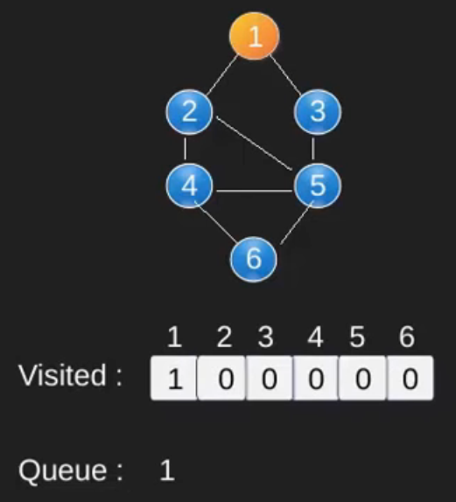
We insert the root node into the queue
visited[root] = 1
Parent:
-1 | -1 | -1 | -1 | -1 | -1

Slide 15
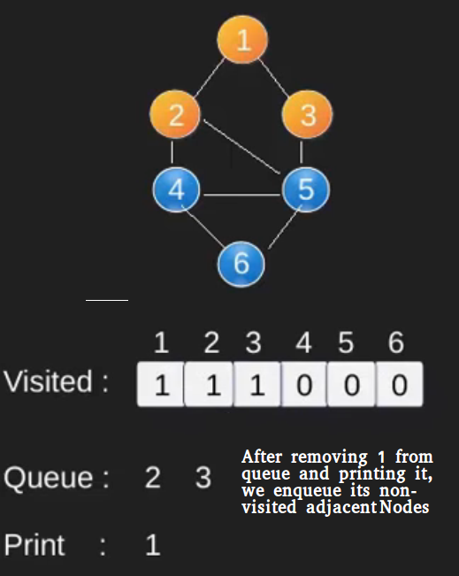
current node = `1
For every non visited neighbour of 1 ie 2,3 :
Mark it as visited. Mark 1 as parent of 2,3
Neither is goal so add both to queue
Parent:
-1 | 1 | 1 | -1 | -1 | -1

Slide 16
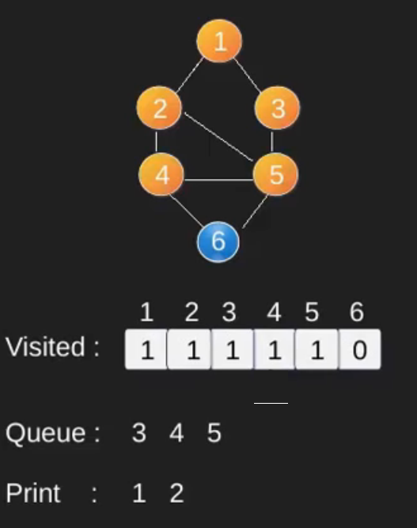
current node = 2
For every non visited neighbour of 2 ie 4,5 :
Mark it as visited. Mark 2 as parent of 4,5
Neither is goal so add both to queue
-1 | 1| 1 | 2 | 2 | -1
Parent:
-1 | 1| 1 | -1 | 2 | -1
Parent:

Slide 17
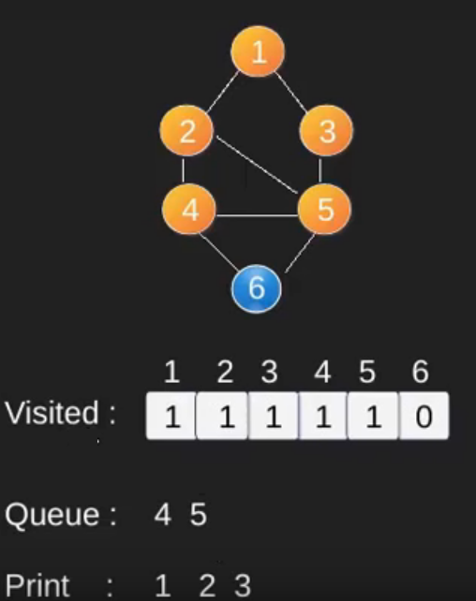
current node = 3
No Unvisited Neighbours for 3 as 4,5 are already visited
Parent:
-1 | 1| 1 | 2 | 2 | -1

Slide 18
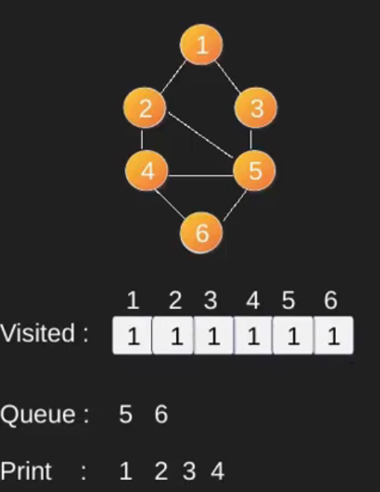
current node = 4
For every non visited neighbour of 2 ie 6 :
Mark it as visited. Mark 4 as parent of 6
6 Is the goal node so stop here
Parent:
-1 | 1| 1 | 2 | 2 | 4

Slide 19
Finally to get path, simply trace back the parent of 6 upto the root
parent[6] -> 4
parent[4] -> 2
parent[2] -> 1
So our path is 1,2,4
Parent:
-1 | 1| 1 | 2 | 2 | 4

Slide 20
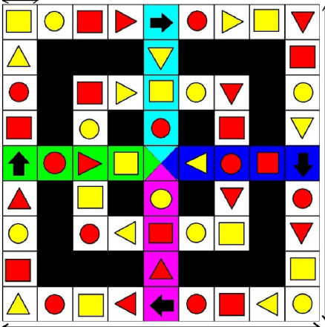

P.S. Application

Slide 21
So the Final Path to Victory May Be
S |  |  |  | G
S |  |  |  | G

Slide 22
Number the vertices. Order does not matter
5 | 6 | 7 | 8 | 8 | 9 | 10 | 11 | 12
4 |  |  |  | 38 |  |  |  | 13
3 |  | 35 | 36 | 37 | 38 | 39 |  | 14
2 |  | 34 |  | 52 |  | 40 |  | 15
1 | 32 | 33 | 51 |  | 53 | 41 | 42 | 16
31 |  | 50 |  | 54 |  | 43 |  | 17
30 |  | 49 | 48 | 46 | 45 | 44 |  | 18
29 |  |  |  | 47 |  |  |  | 19
28 | 27 | 26 | 25 | 24 | 23 | 22 | 21 | 20

Slide 23
Create Adj. Matrix
5 | 6 | 7 | 8 | 8 | 9 | 10 | 11 | 12
4 |  |  |  | 38 |  |  |  | 13
3 |  | 35 | 36 | 37 | 38 | 39 |  | 14
2 |  | 34 |  | 52 |  | 40 |  | 15
1 | 32 | 33 | 51 |  | 53 | 41 | 42 | 16
31 |  | 50 |  | 54 |  | 43 |  | 17
30 |  | 49 | 48 | 46 | 45 | 44 |  | 18
29 |  |  |  | 47 |  |  |  | 19
28 | 27 | 26 | 25 | 24 | 23 | 22 | 21 | 20

Slide 24
Adj. Matrix Will Be 54 x 54
 | 1 | 2 | ...
1 | 0 | 1 | ..
2 | 0 | 0 | ..
... | .. | .. | .

